Slide 1
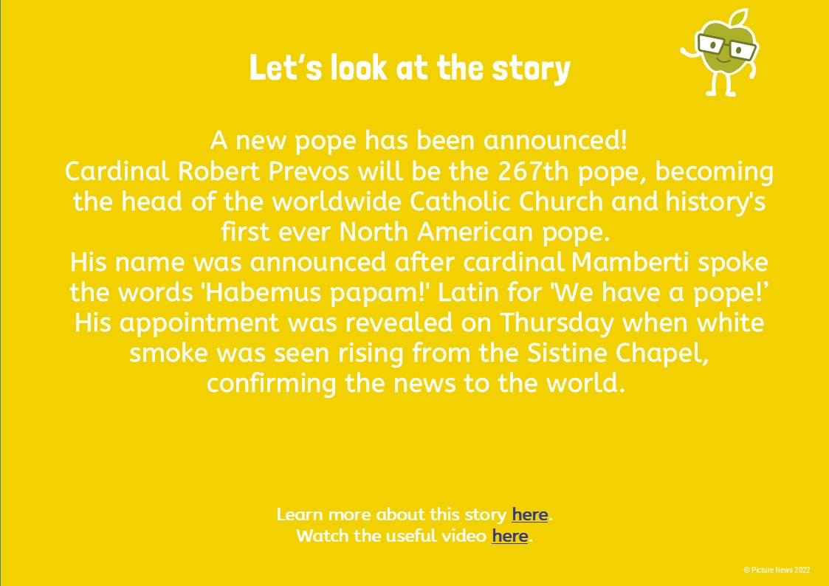
What’s happening
in the news?
Let’s have a look at the poster

Slide 2
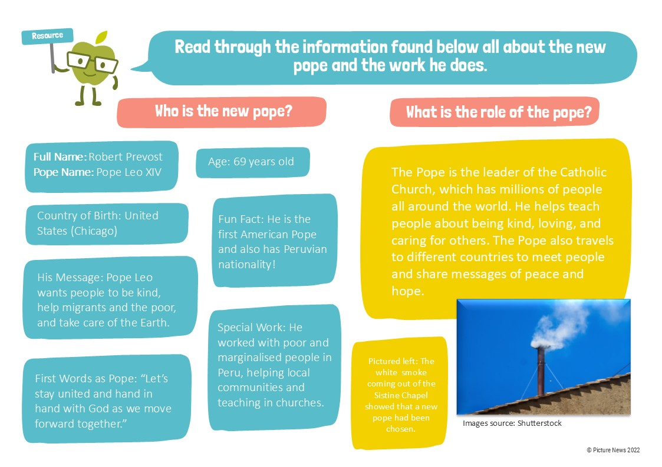
What’s happening
in the news?
Let’s have a look at the poster

Slide 3
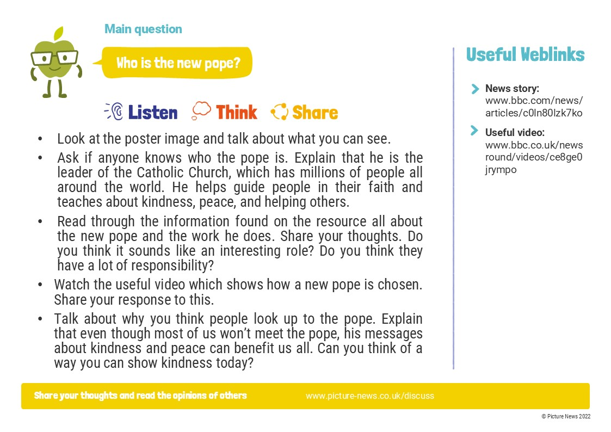
What’s happening
in the news?
Let’s have a look at the poster

