Slide 1

Holy Family Catholic Primary
Welcome to Year 1

Slide 2
Year 1 Staff
Mrs Carey (Miss Bayley)
Mrs Lawson
Miss Magda

Slide 3
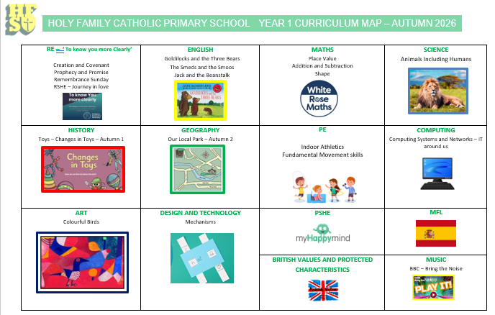
Curriculum Overview - Autumn

Slide 4

Attendance
Every day your child is here, our classroom community is complete.
Consistent school attendance is one of the most powerful ways to keep your child on track academically and socially.
We know that illnesses and emergencies happen, but we want to help minimise unexcused absences.
Please inform the school office via phone or our attendance email: attendance.hfp@schools.sefton.gov.uk
If you need to collect your child before 3:30pm, please provide a reason/ appointment letter/ text in advance.

Slide 5

Start of the day
The school gates will be open at 8:45am and children should make their way to their classroom. The school gates will be closed at 8:55am.
The day starts with Morning Maths, Spelling and Grammar
During the register, Children will respond with the colour they have placed themselves on the Zones of Regulation to let us know how they are feeling.

Slide 6

PE
Our PE lessons will take place on Wednesday and Thursday.
PE Kit - white top, black shorts or dark tracksuit bottoms. No earrings.

Slide 7
Homework
Reading - Reading books will be changed on a Monday and Wednesday and a library book of your child's choice will be sent home on a Friday. They must have been heard reading at home (recorded in their reading record) as well as in school.
Numbots - 20 minutes weekly.
Mix of Maths and English weekly activities.

Slide 8
Code of Conduct
At Holy Family we:
Live, Love and Learn as followers of Jesus Christ
1. Respect ourselves, each other and our environment
2. Keep ourselves and each other safe
3. Listen to each other and talk through our problems
4. Take responsibility for our actions

Slide 9


RSHE
Our Relationship and Sex Education programme is called ‘Journey in Love’. The programme has been approved by the Liverpool Archdiocese Schools team and has been adopted across all schools in the archdiocese.
All pupils will follow 5 themes from Reception to Year 6; Physical, Social, Emotional, Intellectual and Spiritual.
This content runs alongside our RE, Science and PSHE topics throughout the year.
We also use ‘Picture News’ and ‘No Outsiders’ to assist with the delivery of our RSHE curriculum. Through discussion about current events and the use of age-appropriate books, we aim to promote an inclusive education and community cohesion by teaching children about diversity and acceptance.
More information is available on our website - https://www.holyfamilyprimary.com/rshe-1/ .

Slide 10





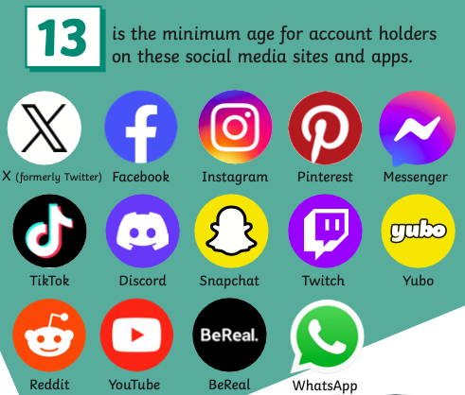



Online Safety - Keeping Children Safe Online
Children must be at least 13 to register on most social networking websites. Age limits are there to keep children safe so you shouldn’t feel pressurised into letting younger children join these websites or use apps/games that are not age appropriate.
Open dialogue with your child
Encourage your child to only access online games that are appropriate for their age and always check the age rating on any game/app before buying or downloading it for your child.
Family agreement
Consider filtering & blocking software
Think before you/they post
Understand the laws
Privacy settings and reporting
Save the evidence and report the incident
Age ratings on apps and games
Protect their personal information
Further information - www.saferinternet.org.uk

Slide 11


Slide 12
Contact information
Should you need to contact the class teacher, please use our class email: year1.hfp@schools.sefton.gov.uk
Please note that we will read emails outside of our teaching day, if something needs to be passed on immediately, contact the office who will be able to pass this on to the class teacher.
If you feel that you need to speak to the class teacher, please phone the office and we can make an appointment for a telephone discussion.

Slide 13
Social Media
We regularly update our Facebook and Twitter with information and share photographs of all the exciting things going on in school.
You can follow us on Facebook:
Holy Family’s Reception Class Southport
Holy Family Catholic Primary School Southport
You can also follow us on Twitter:
@HolyFamilyCP

