Slide 1

ROBINWOOD RESIDENTIAL
Year 6 Trip
Autumn Term

Slide 2
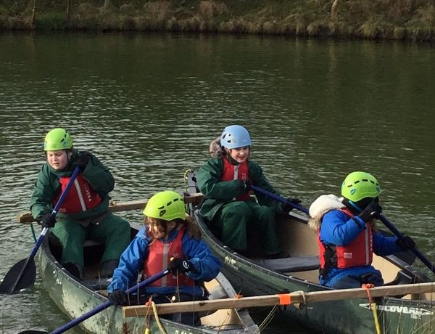
DATES AND TIMES
Leaving on the 17th September at 9:30am.
Children will go straight onto the coach from 9:15am and children in breakfast club will be collected by staff.
Returning on the 19th September approximately 3:30pm.

Slide 3
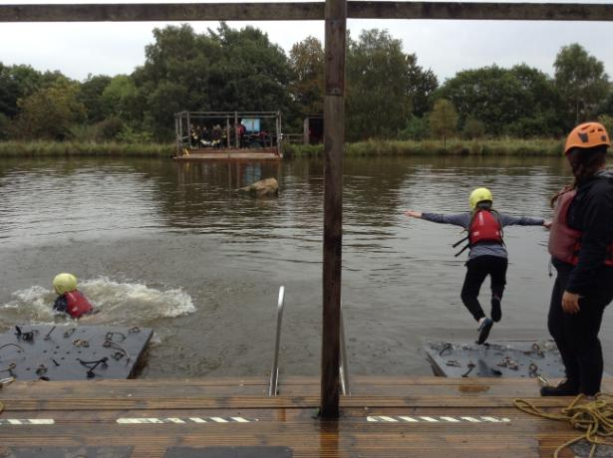
ON ARRIVAL
Children will be given a H&S briefing by staff onsite, and shown around the building.
They will then be put into their dorm groups and shown to their rooms.

Slide 4
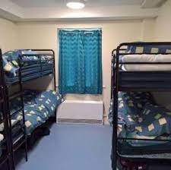
DORMS AND SLEEPING ARRANGEMENTS
Dorms are split into boys and girls – groups will be shared before we leave.
Children will be given some choice in their dorms and who they share a dorm with.
Staff onsite 24 hrs
Hall lights are automatic, so children will be able to find their way to the toilet.
There are no snacks in dorms!
Children will be shown where the teachers rooms are.

Slide 5
BEDTIMES
Bedtimes are set each night at the same time.
Holy Family staff will be around to assist with making sure children get to sleep okay.
We have additional dorms available which we can move children into if there are any issues with going to sleep, so other children aren’t affected.

Slide 6
EATING/ FOOD
Breakfast – Wide variety for children to chose from.
Lunch –There will be choices of a variety of a hot meal or wraps/ sandwiches for the other days.
Tea – Wide choice of meals throughout the stay.
Snacks – Regular fruit and breaktime snacks given throughout the day.
Dietary Requirements – There is a variety of
options available for all dietary requirements.

Slide 7
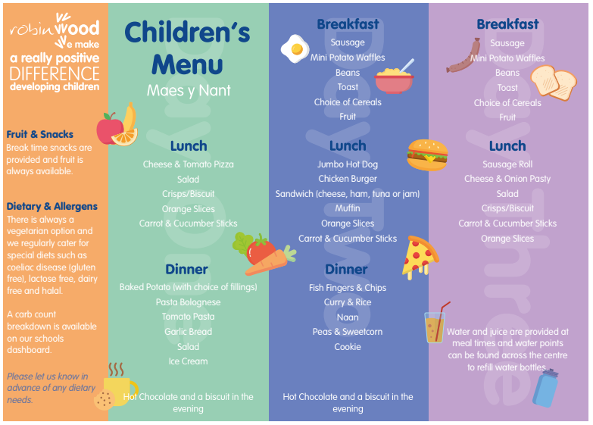

Slide 8
STAFF ATTENDING
Miss Veevers – Party Leader
Mr Davies
Mr Hassall
Robinwood staff are on call 24hrs to support with evenings and bedtimes.

Slide 9
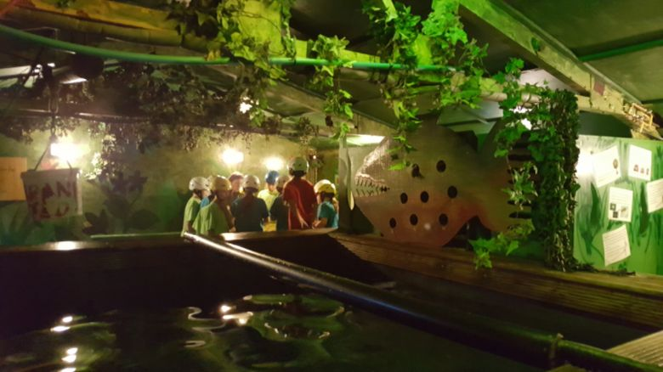
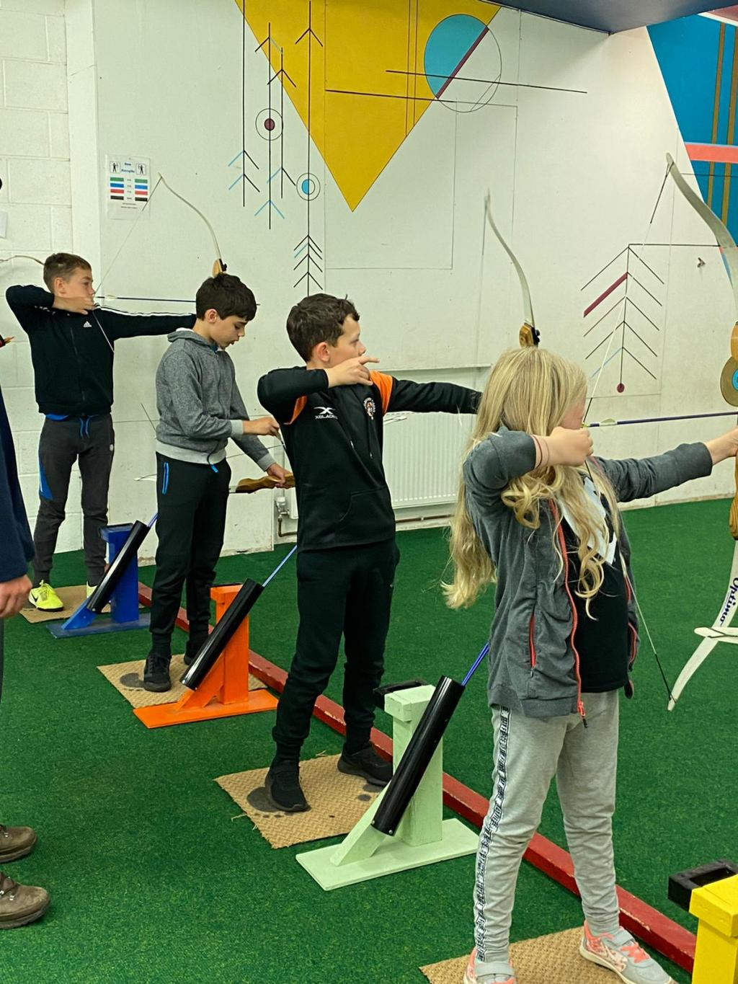
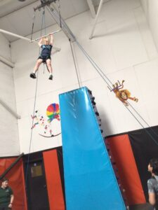
ACTIVITIES
There is a wide range of activities that the children will have the opportunity to try:
Canoeing
Archery
Caving
Rock Climbing
Zip wire
Trapeze
And many more!

Slide 10
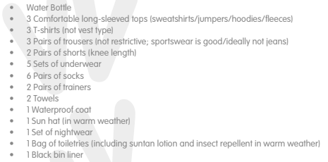
KIT LIST
The majority of activities are outdoors, so suitable clothing is needed. All specialist equipment is provided.
Please see the kit list here.

Slide 11
NOTES ON KIT LIST
Please ensure that clothes are named – there will be lots of changes through the day, and lots of clothes put in the dry room.
There is no need to exceed the numbers in the list provided.
Due to the nature of some activities, some clothes
may be slightly damaged/ ripped. I suggest older
clothes are best/ ones that you don’t mind getting muddy!

Slide 12
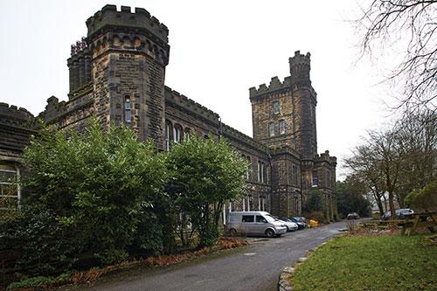
WHAT NOT TO BRING
No devices – Mobile phones, iPads and Tablets, cameras. If someone needs to be contacted, Miss Veevers can do so, and regular updates will be sent to school to be shared.
No Aerosol sprays – the fire alarms are quite sensitive to ensure high standards of fire safety.
No bedding is needed – all is provided by the centre.

Slide 13
MEDICATION
You have already sent in your medical forms, but if anything has changed since then, please let me know and we can update this. This also applies to any dietary requirements.
Any medication will need to be brought into the office next Monday or Tuesday in a named bag – children are not permitted to bring their own medication.

Slide 14
ANY QUESTIONS?

Slide 15
QUESTIONS FROM MEETING
How often do children get breaks from activities?
After every activity, there will be an opportunity for the children to come back and grab a snack and fill water bottles. There are lots of areas for the children to play during free time in between activities and before any evening activities.
Bedtimes – I have made a slide for this after dorms/ sleeping arrangements.
How will we be getting there?
Most children will be on the minibus (Either Mr. Cafferty or Mrs. Critchley will be driving). A small group of children will travel with Mr. Brough, and Miss Fitton will be driving with all of the luggage.

