Slide 1

Welcome to
Holy Family Reception
Class RL

Slide 2
Living, loving, learning as followers of Jesus Christ

Slide 3
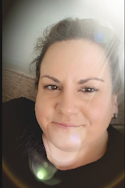
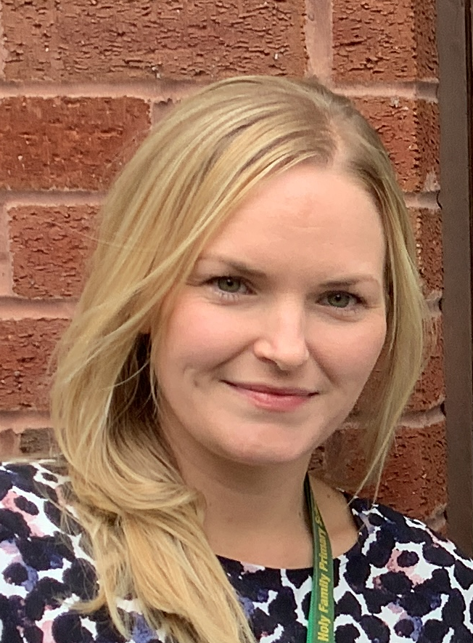
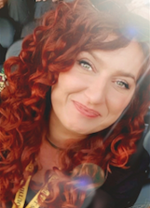
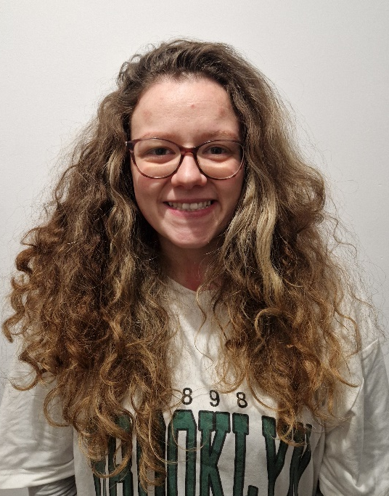
Reception Team
Miss Loveless
Teacher
Miss Crouch
Teacher
Mrs Clementson
T.A
Miss Magda
T.A
Start of the day -
Children should be on the playground, ready to line up at 8:55 when the classroom doors are opened.
.

Slide 4


Class RCL Rules
We go for green!

Slide 5



Please label everything!
Coats
Jumpers/cardigans
Water bottles
Book bags
Shoes
Track suit bottoms and hoodies
REMINDER
EARRINGS THAT ARE WORN SHOULD ONLY BE SMALL STUDS
REMEMBER TO BRING IN A NAMED PAIR OF WELLINGTON BOOTS

Slide 6


Book Bags
Children need to bring in their book bags every
MONDAY, WEDNESDAY and FRIDAY.
Book bags do not need to come to school on other days.
Homework is given on Friday and needs to be returned on Wednesday.
When your child is ready to bring a book home, they will have a Phonics Read, Write Inc or Oxford Little Blending book.
This book is read Mon – Fri at home.
Every Friday your child will bring home a book from the class library. This is a book to share with your child – reading together for enjoyment.
Please remember to label all uniform – especially jumpers, cardigans and coats.
Children need to bring in their own water bottle every day – please remember children should only have water in the bottle. Many thanks

Slide 7

PE – Class RL
Tuesday
Please come to school in kit
White top, black shorts, dark tracksuit bottoms/hoody (MUST BE LABELLED), trainers/pumps.
Additional physical activities will take place during the week but a kit is not required
Children should not wear earrings on PE day.

Slide 8
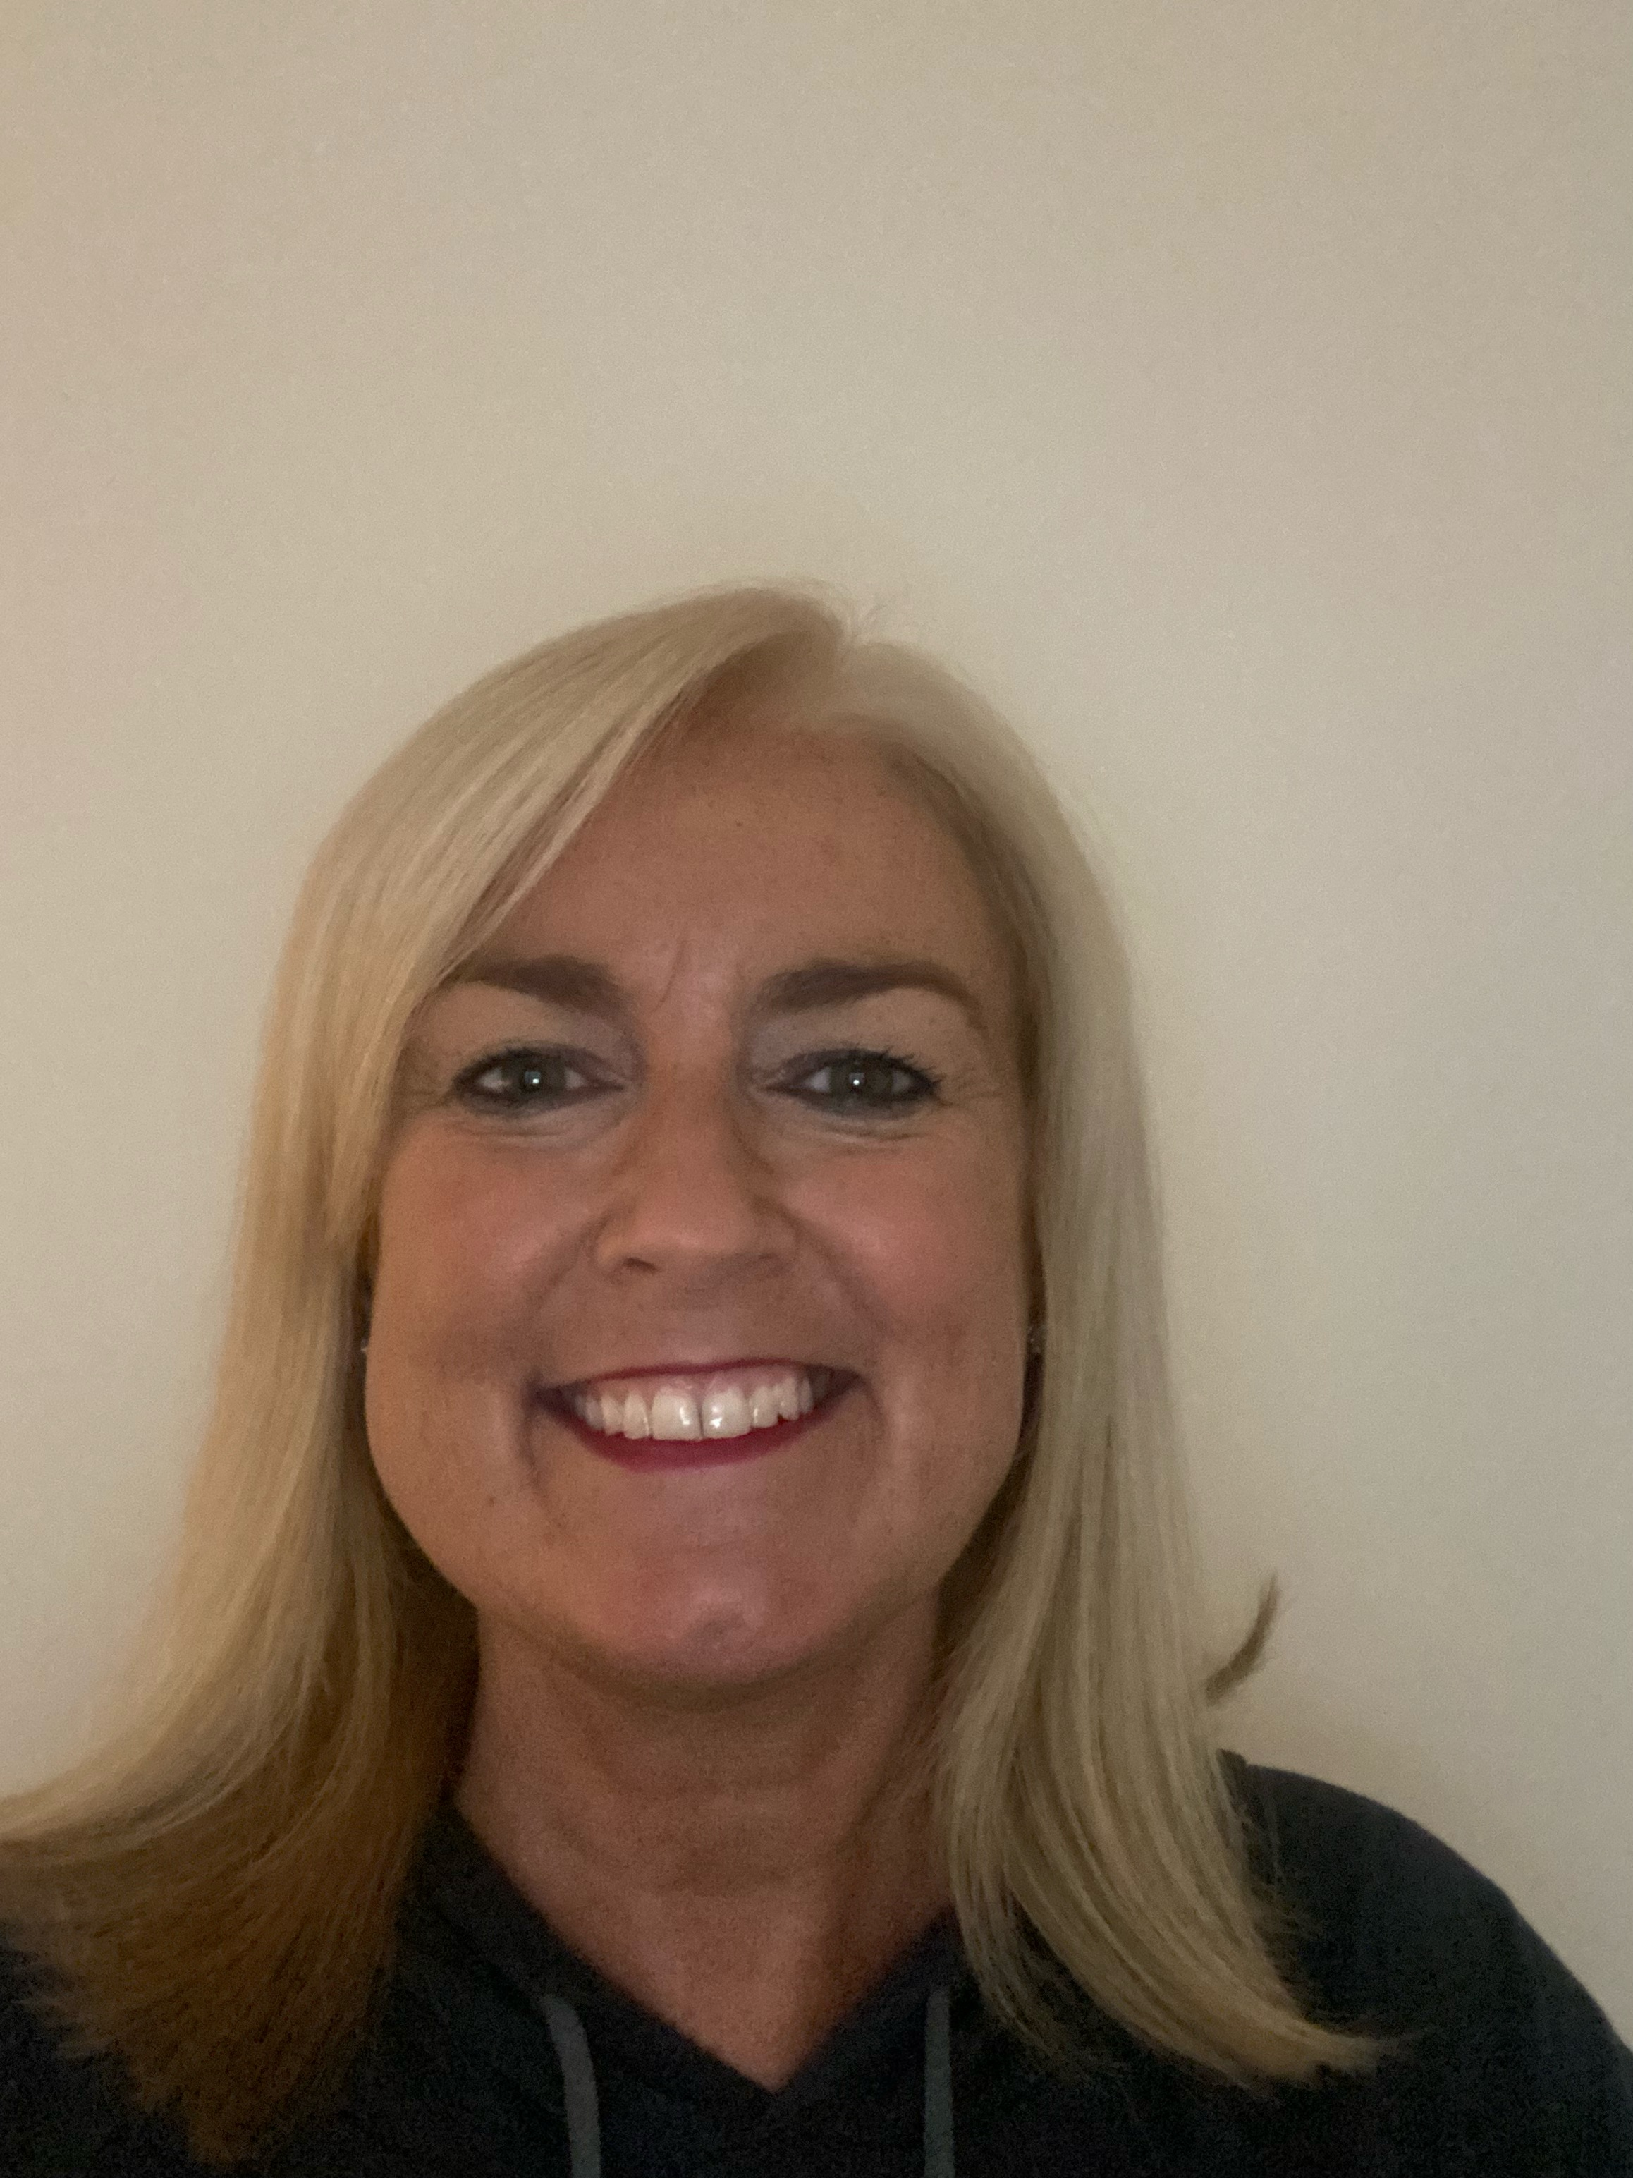

Safe and Secure
Safeguarding and Child Protection Team
Miss Loveless – Designated Safeguarding Lead
Miss. Hilton – Designated Person
Mrs. Scott – PSA & Designated Person

Slide 10



Online Safety
Before you tap and click…
You need to stop and think…
And TELL someone!

Slide 11






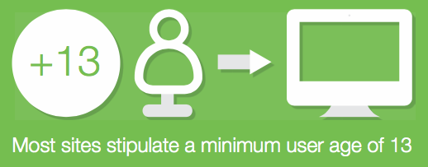

Keeping Children Safe Online
Open dialogue with your child
Children must be at least 13 to register on most social networking websites. Age limits are there to keep children safe so you shouldn’t feel pressurised into letting younger children join these websites or use apps/games that are not age appropriate.
Family agreement
Consider filtering & blocking software
Think before you/they post
Understand the laws
Privacy settings and reporting
Encourage your child to only access online games that are appropriate for their age and always check the age rating on any game/app before buying or downloading it for your child.
Save the evidence and report the incident
Age ratings on apps and games
Protect their personal information
Further information - www.saferinternet.org.uk

Slide 12
Snack – Fruit Daily
If you need to speak to me or pass on a message and you haven’t seen us at the gate, please phone the school office 01704 213 084 or e-mail.
Class e-mail address -
reception.hfp@schools.sefton.gov.uk
Thank you – Miss Loveless

Slide 13


