Slide 1
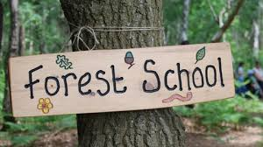
Forest School
Delivered by Forest School Leaders Tom and Liam

Slide 2
What is Forest School?
Forest School involves learning outdoors in a woodland.
Originating in Scandinavia
It builds on ideas from popular theorists that a child learns from the inside out. It is the job of a teacher to draw out that knowledge.
Children can choose to take part in various activities such as den building, crafting with tools, building fires, climbing trees, nature conservation and cooking.
Over the past 25 years, there have been a range of studies that show Forest School develops the whole child (Social, emotional and physical)
Studies show an increase engagement with parents/carers, teachers and the general public due to the ethos of Forest school.
Notes:
Forest School is an educational approach where children learn outdoors, mostly in natural spaces like forests, parks, or woodlands. It started in Scandinavia and focuses on children exploring and learning by doing. Instead of sitting in a classroom, children take part in activities like building shelters, exploring nature, and observing wildlife. The aim is to help children develop practical skills, creativity, and confidence, while encouraging them to solve problems and take safe risks. Forest School supports all aspects of a child's development—physical, social, emotional, and mental—by connecting them with nature. It is becoming more popular around the world as a fun, hands-on way for children to learn outside the traditional classroom setting

Slide 3
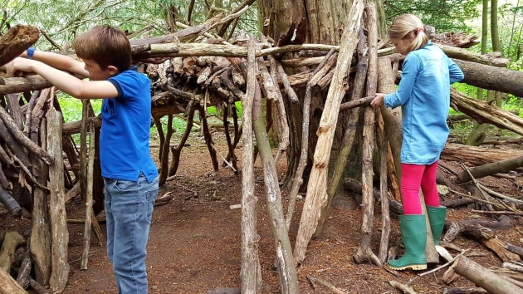
Forest School Principles
1. Forest School is a long-term process
2. Forest School takes place in a natural wooded environment
3. Forest School aims to promote holistic development
4. Forest School offers learners the opportunity to take supported risks
5. Forest School is run by qualified Forest School practitioners
6. Forest School uses a range of learner-centred processes
Notes:
Forest School takes place regularly, ideally at least every other week, with the same group of learners, over an extended period of time, if practicable encompassing the seasons.
• A Forest School programme has a structure which is based on the observations and collaborative work between learners and practitioners. This structure should clearly demonstrate progression of learning.
• The initial sessions of any programme establish physical and behavioural boundaries as well as making initial observations on which to base future programme development
Whilst woodland is the ideal environment for Forest School, many other sites, some with only a few trees, are able to support good Forest School practice.
• The woodland is ideally suited to match the needs of the programme and the learners, providing them with the space and environment in which to explore and discover.
• A Forest School programme constantly monitors its ecological impact and works within a sustainable site management plan agreed between the landowner/ manager, the forest school practitioner and the learners.
• Forest School aims to foster a relationship with nature through regular personal experiences in order to develop long-term, environmentally sustainable attitudes and practices in staff, learners and the wider community.
• Forest School uses natural resources for inspiration, to enable ideas and to encourage intrinsic motivation.
Forest School opportunities are designed to build on an individual’s innate motivation, positive attitudes and/or interests.
• Forest School uses tools and fires only where deemed appropriate to the learners, and dependent on completion of a baseline risk assessment.
• Any Forest School experience follows a Risk–Benefit process managed jointly by the practitioner and learner that is tailored to the developmental stage of the learner.
Forest School Leaders meet participants where they are and ensure that participant’s choice underpins the opportunities offered throughout sessions.
Forest School Leaders recognise that behaviour is communication. Leaders create and maintain a Forest School Handbook that sets out how they approach behaviours that may challenge.
Forest School Leaders plan sessions that offer mixed opportunities for participants to develop their physical, social, cognitive, linguistic, emotional and spiritual selves (for example, through a mix of opportunities that might include climbing/balancing, circles, reflection, nature connection, team tasks/games, problem solving, creative endeavours), and take risks (emotional, social, physical).
• Forest School is led by qualified Forest School practitioners, who are required to hold a minimum of an accredited Level 3 Forest School qualification.
• There is a high ratio of practitioner/adults to learners.
• Practitioners need to hold an up-to-date first aid qualification, which includes paediatric (if appropriate) and outdoor elements.
• Forest School is backed by relevant working documents, which contain all the policies and procedures required for running Forest School and which establish the roles and responsibilities of staff and volunteers.
• The Forest School leader is a reflective practitioner and sees themselves, therefore, as a learner too.
• A learner-centred pedagogical approach is employed by Forest School that is responsive to the needs and interests of learners.
• The Practitioner models the pedagogy, which they promote during their programmes through careful planning, appropriate dialogue and relationship building.
• Play and choice are an integral part of the Forest School learning process, and play is recognised as vital to learning and development at Forest School.
• Forest School provides a stimulus for all learning preferences and dispositions.
• Reflective practice is a feature of each session to ensure learners and practitioners can understand their achievements, develop emotional intelligence and plan for the future.
• Practitioner observation is an important element of Forest School pedagogy. Observations feed into ‘scaffolding’ and tailoring experiences to learning and development at Forest School.

Slide 4
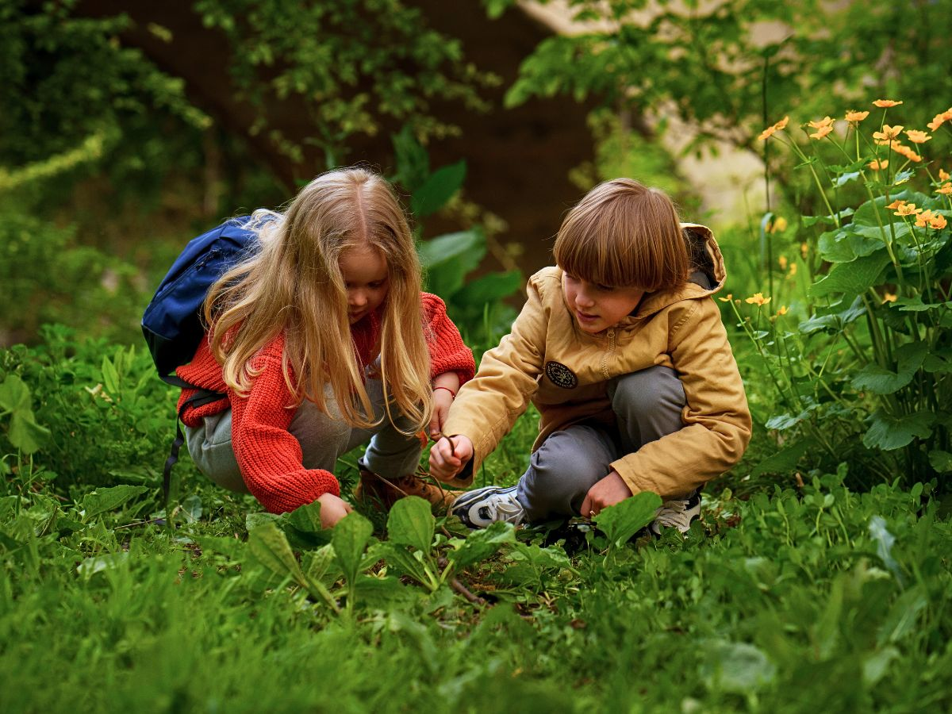
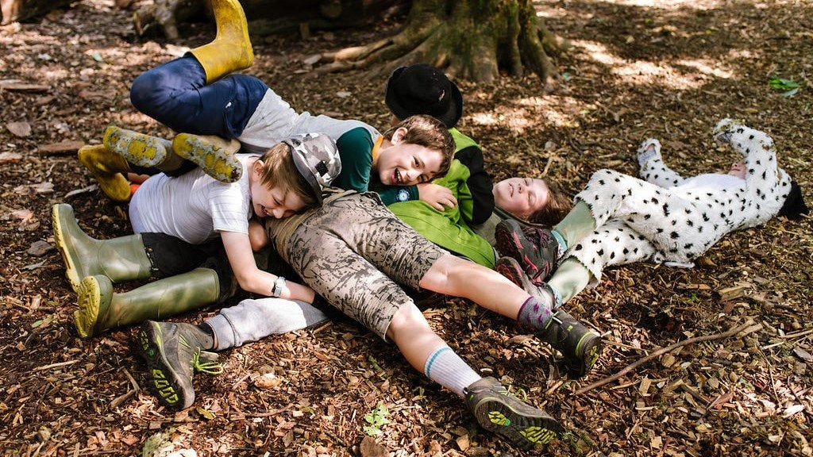
Behaviour at Forest School
Encouraging Respect for Others
Managing Risk Responsibly
Problem-Solving and Conflict Resolution
Emotional Development
Notes:
At Forest School, the approach to behaviour focuses on positive, respectful, and cooperative interactions in a natural, outdoor setting. The key elements of this approach include:
Children are taught to respect each other, their peers, the environment, and themselves. This includes listening to others, being kind, and following rules that help ensure safety.
Children are encouraged to assess and manage risks themselves. This builds their awareness of personal safety and helps them make informed decisions while engaging in activities.
If conflicts arise, children are guided through problem-solving processes to resolve issues independently. This helps them develop important social skills like negotiation, compromise, and empathy.
Forest School recognises the importance of emotional development and provides a safe space for children to express their feelings. Leaders encourage self-regulation and support children in understanding and managing their emotions.
Overall, the approach to behaviour at Forest School is nurturing, supportive, and focused on helping children learn to make positive choices in a natural, engaging environment.

Slide 5
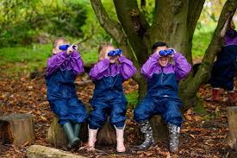
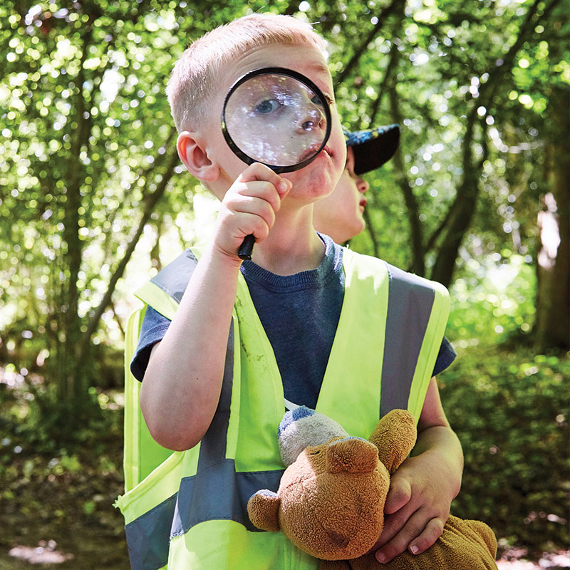
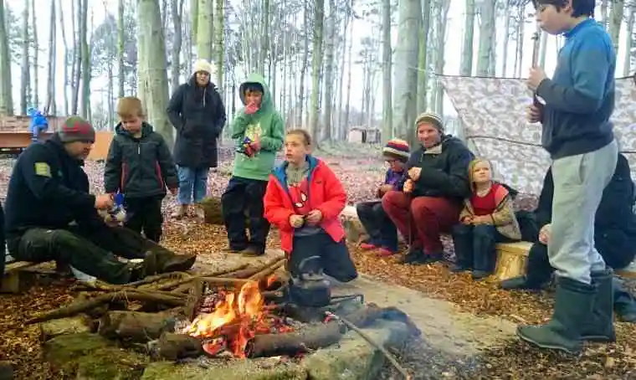
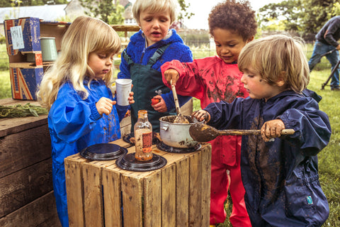
Activities at forest school
Building Shelters and Dens:
Nature Exploration
Fire Safety, Lighting and cooking
Managing risks
Creative Art
Notes:
At Forest School, children may choose to participate in a range of engaging outdoor activities, including:
Building Shelters and Dens: Encourages teamwork, creativity, and problem-solving using natural materials.
Nature Exploration: Children go on nature walks to observe wildlife, plants, and learn about their environment.
Fire Safety, Lighting and cooking: Under supervision, children learn to build and light small fires, teaching responsibility and practical skills.
Managing risks: Activities like tree climbing and balancing on logs help build physical strength, confidence, and risk assessment.
Creative Nature Art: Children use natural materials to create art, fostering creativity and fine motor skills.
These activities help children develop essential life skills while connecting with nature in a safe, supportive environment.

Slide 6
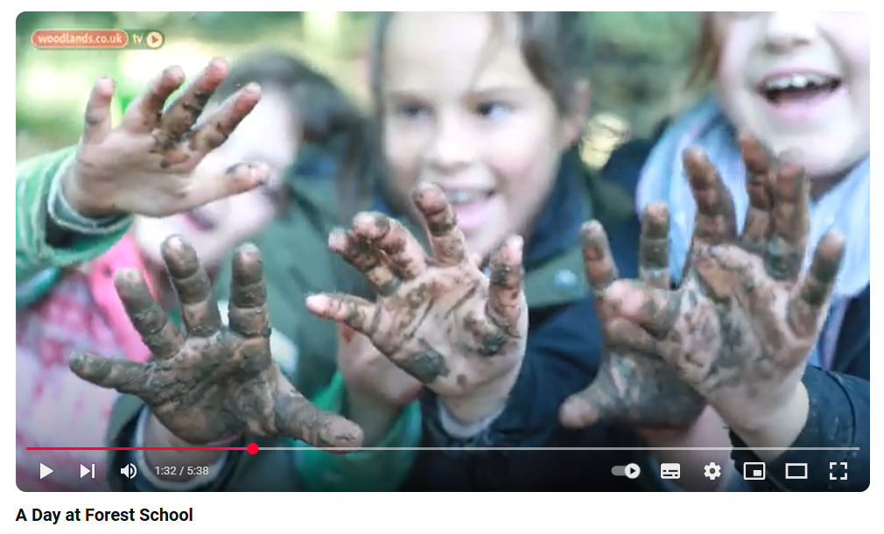
What does Forest School look like?
https://www.youtube.com/watch?v=-9ADLZv7jms

Slide 7
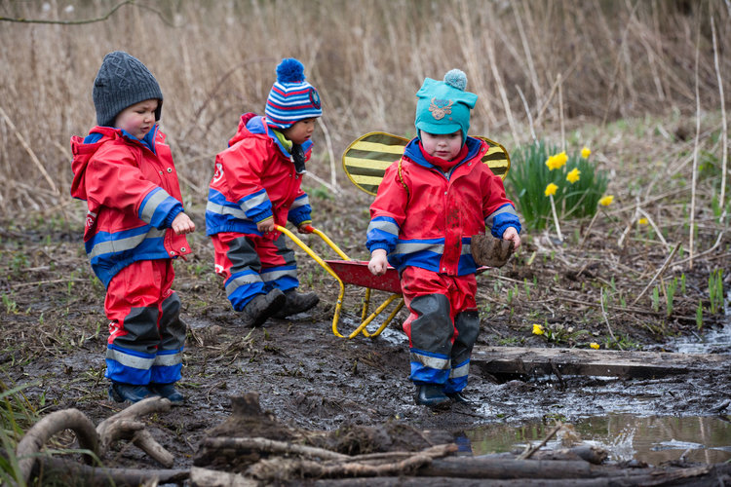
Whatever the weather
Children will experience all different weather conditions.
Duty of the Forest School Leader to ensure children have access to their basic needs (shelter, food, water, warmth)
Clothing varies slightly through Autumn, Spring Summer and Winter
Long sleeved t-shirts and long pants are essential
Notes:
Ensuring Basic Needs:
The Forest School Leader should always ensure children have access to shelter, food, water, and warmth. In outdoor environments, these basic needs can be harder to maintain, especially in extreme weather conditions. The leader must assess the situation and respond accordingly to ensure children’s health and safety.
Weather-Appropriate Clothing: The weather can change rapidly, and it's important for children to be dressed for all conditions. In terms of clothing:
Autumn and Spring: Layering is key. A long-sleeved t-shirt, waterproof jacket, and layers to add or remove as needed. Children should also have hats or light scarves for wind or light rain.
Summer: While the temperatures might be warmer, children still need to be protected from the sun. Long-sleeved shirts and long pants can protect from sunburns, while breathable materials will help with comfort. Sunscreen and hats are essential as well.
Winter: Warm clothing is crucial, including insulated coats, hats, gloves, scarves, and boots. Thermal layers are helpful for keeping warmth, and waterproof clothing is important for snow or rain.
Shelter and Protection: When ‘poor’ weather occurs (e.g., wind, heavy rain, or snow), we will ensure that there is a sheltered area where children can take refuge. This could be a temporary shelter, a well-constructed natural space, or a permanent structure i.e the pavilion.
Health and Safety: Be aware of the potential risks posed by certain weather conditions, such as frostbite or heat exhaustion, and educate the children on how to stay comfortable. Hydration is particularly important during hot weather, and keeping warm during colder months is essential.
Food and Hydration: Having healthy, easy-to-carry snacks and enough water is important for maintaining energy levels during outdoor activities. This is especially important during long sessions in cold or hot weather when the body needs extra nourishment.
By ensuring that children are well-prepared for any weather, you’ll not only help them stay safe but also make outdoor learning experiences more enjoyable and educational.
Places to source suitable clothing – sports direct, decathlon, go outdoors, mountain warehouse
Practise putting on the layers. Get used to what it feels like. We are there to facilitate so we will leave as much of the getting ready to the children.

Slide 8



Questions?
Thank you for taking the time to come and listen. We hope that all the children will thoroughly enjoy the adventure!

